Slide 1

Early Childhood Education

Slide 2

Empowering Mankind
MySkill - Empowering womanhood, is program with a vision to give a platform to all the women for diversifying their existing skills to meet today's challenges. MySkill aims at building actual competencies to achieve their highest desired level of independence and inclusion in their communities.
MySkill has partnered with institutes who have a proven track record of training and empowering women through various educational and experiential learning in the past.
MySkill offers a platform for all aspiring women who want to have a greater expansion in professional and personal growth which in turn contribute to structural transformation and economic growth by enhancing employability.

Slide 3
Agenda
Introduction to Early Childhood Education
Benefits of Early Childhood Education
Preparing for School
Understanding Child Behaviour
Signs of Difficult Behaviour
Handling Inappropriate Behaviours
Five Stages of Child Development
Importance of Developmental Milestones
Role of Trainers in Development
Connecting with a Child
Conflict Resolution Skills

Slide 4

Introduction to Early Childhood Education
Overview
Plus tip:
Consider adding examples of specific programs or methods used in early childhood education to enhance this slide.
Definition of Early Childhood Education
Age Range Covered
Early childhood education is the period of learning that takes place typically from birth to age eight. It lays the foundation of all learning during these critical years.
The early years, from 0 to 8 years, are the most extraordinary period of growth and development in a child’s lifetime.
Foundational Aspects
Significance
This period encompasses essential areas of development: physical, social, intellectual, academic, and emotional.
The foundations of all learning are laid during these years, making early childhood education vital for future success.

Slide 5
Benefits of Early Childhood Education
Benefits
Plus tip:
Consider adding statistics or quotes from research studies to enhance the credibility of each benefit.
Improves Social Skills
Linked to Greater Success in Life
Early childhood education fosters social interactions and helps children develop essential social skills necessary for building relationships.
Research indicates that early childhood education is linked to greater success in life, contributing positively to future academic and professional achievements.
Offers Health and Behavioral Screenings
Positively Impacts Society
Programs often provide screenings for health and behavioral issues, ensuring children receive early interventions when necessary.
Investing in early childhood education positively impacts society by reducing future social costs and improving community well-being.

Slide 6
Preparing for School
Child Psychology
Early childhood education plays a crucial role in preparing children for school by fostering independence and instilling new routines. By engaging in structured activities, children learn to manage their time and responsibilities, which enhances their ability to transition into a formal school environment. This stage of education also emphasizes the development of social skills and emotional regulation, both essential for successful interactions in a classroom setting. Through various educational experiences, children gain the confidence needed to navigate school life effectively.

Slide 7
Understanding Child Behaviour
Child Behaviour
Plus tip:
Consider including specific examples of good and bad behaviors relevant to different age groups to further illustrate these concepts.
Definition of Child Behaviour
Good vs. Bad Behaviour
Importance of Behaviour
Child behavior is defined as "the actions, reactions and functioning in response to everyday environments and situations." Understanding behavior is critical for assessing a child's developmental health.
Good behavior promotes health and enhances quality of life, while bad behavior can lead to social isolation and challenges. Good behaviors include cooperation, sharing, and following directions, whereas bad behaviors might include defiance and aggression.
Behavior is important as it leads to better health and quality of life. Challenging behavior can cause social isolation and may contribute to mental health issues, such as loneliness and depression from an early age.

Slide 8
Signs of Difficult Behaviour
Child Behaviour
Gets frustrated easily.
Displays opposition to parent or adult requests.
Has frequent tantrums.
Has tantrums that last for a long time.
Is difficult to discipline.

Slide 9
Handling Inappropriate Behaviours
Child Behaviour
Plus tip:
Consider adding examples or scenarios to illustrate these strategies effectively.
Strategies for Managing Inappropriate Behaviours
Importance of Supportive Responses
Listen to the child by actively nodding and repeating back their feelings.
Don't criticize a child's behavior to avoid embarrassment.
Try not to overreact, as it can escalate the situation.
Listening helps children feel heard and understood.
Supportive responses foster trust and openness.
Managing reactions can lead to better behavior outcomes.

Slide 10
Five Stages of Child Development
Developmental Milestones
Plus tip:
Consider adding visuals or examples of activities that correspond to each developmental stage to enhance engagement.
Newborn (0-3 months)
Infant (3-12 months)
Toddler (1-3 years)
Preschool Age (3-4 years)
Rapid growth and basic reflexes develop. Newborns communicate through crying and cooing, recognizing caregivers.
Infants gain control over movements, exploring their surroundings. They sit, crawl, and begin to walk, engaging with caregivers through smiles and babbles.
Language develops significantly, and toddlers assert independence. They engage in parallel play and start to understand sharing and taking turns.
Children enhance social skills, form friendships, and engage in imaginative play. They recognize letters and numbers and understand basic rules.
Physical growth chart
Reflex development checklist
Motor skills assessment
Social engagement observation
Language development report
Play interaction logs
Social skills evaluation
Imaginative play assessment

Slide 11
Importance of Developmental Milestones
Development
Plus tip:
Consider adding specific examples of developmental milestones to illustrate their importance.
Identifying Delays
Developmental milestones offer important clues about a child’s developmental health.
If a child doesn't reach a milestone at the typical age, it could indicate a developmental delay.
Early identification of delays can lead to timely interventions, improving outcomes for the child.
Building a Foundation for Future Learning
Milestones help children develop skills that form a strong foundation for future learning.
Understanding milestones ensures that children receive appropriate support during critical growth stages.
Tracking milestones can guide parents and educators in fostering each child's unique developmental journey.

Slide 12
Role of Trainers in Development
Development
Plus tip:
Consider adding specific examples of mentorship techniques or types of meaningful experiences that trainers can create.
Mentorship
Providing mentorship is crucial for trainers as it helps guide children's development by offering support and encouragement tailored to each child's needs.
Inspiring Learning
Trainers play a vital role in inspiring learning by nurturing healthy curiosity in children, encouraging them to explore and ask questions.
Creating Meaningful Experiences
Creating meaningful learning experiences involves leveraging technology and mediating interactions to connect children with their learning environment.

Slide 13
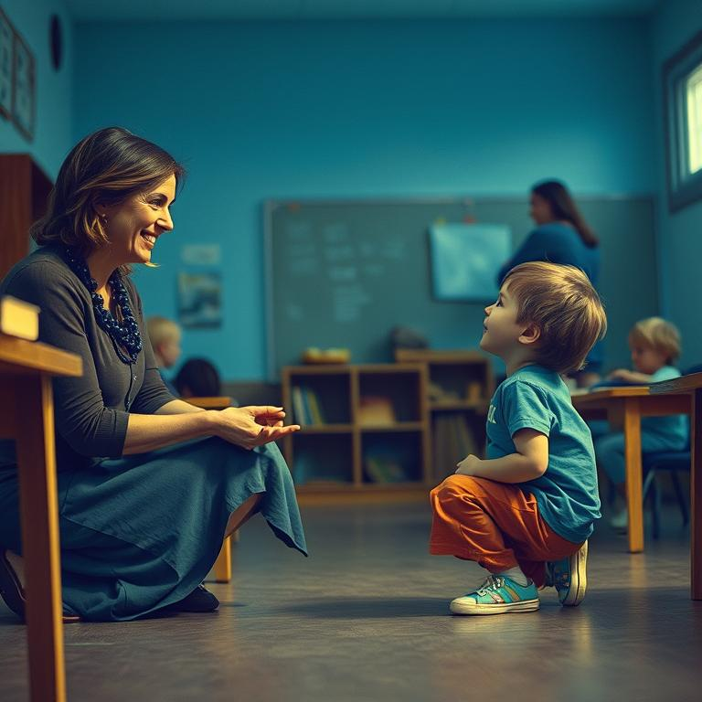
Connecting with a Child
Child Psychology
Effective Connection Strategies
Acknowledge children's efforts by praising their accomplishments, no matter how small, to build their self-esteem and confidence.
Engage in children's play by joining them in their activities, which helps to foster trust and strengthen the bond between caregiver and child.
Use calm communication by maintaining a soothing tone and body language, which creates a safe environment for children to express themselves.
Make eye contact and actively listen to children, ensuring they feel heard and valued, which is crucial for social and emotional development.
Plus tip:
Consider incorporating specific examples of activities or phrases you use to connect with children in your own context. This could enhance relatability and applicability.

Slide 14
Conflict Resolution Skills
Conflict Resolution
Plus tip:
Consider adding examples of each skill in practice to enhance understanding.
Active Listening Skills
Patience
Use of Humor
Active listening focuses on being attentive to what the other person has to say. It involves nodding and repeating back what you think the other person is feeling, which helps them feel heard.
It's important to keep in mind that the problem may not be solved right away, even if the solution seems obvious. Patience is crucial in resolving conflicts.
Try using humor while trying to resolve conflicts if you know the situation is not severe. Humor can lighten up the mood and resolve tension.

Slide 15

MySkool is an inspiration for schools, teachers, parents and students to excel in life. It is a message that ‘good is always appreciated.’ It is a push towards self motivation, an opportunity to see how others are growing and a chance to appreciate fellow human beings.

